Slide 1
AI Development on the Cheap
By Gregory Patmore

Slide 2
TOC
Who Am I?
Who are you?
What do you mean AI?
How much is this gonna cost me?
Can you show me?
Can we talk about this?

Slide 3

Who Am I?
I am a…
Technologist
Consultant
Director of Reliability Practice @ Cognizant Technology Solutions
Proud Father of a Poly Ingenuity Student
People call me ‘grep’
Interested in Tech, Anime, Video Games, Weird Skills, Sneakers, and Collecting Playing Cards
Life Goal is to open a video game company
Married for 16yrs
20+ years Industry Experience
Casual Video Gaming
Real Money Gaming
Content Analytics
Media Streaming
Banking/ Financial Services
Stock Markets
Airline/Travel
Healthcare
Insurance
Restaurant/Hospitality
Retail

Slide 4
What do you know about AI?

Slide 5
What do you mean AI?
Machine Learning: This type of AI focuses on enabling systems to learn from data without being explicitly programmed. It involves algorithms that can improve their performance over time as they are exposed to more data (ML)
Natural Language Processing: This field focuses on enabling computers to understand, interpret, and generate human language. It enables applications like translation, sentiment analysis, and voice-activated assistants (GenAI)
Computer Vision: This area enables AI to "see" and interpret images and videos. It involves algorithms that can analyze visual data to identify objects, recognize patterns, and understand scenes
Robotics: This field combines AI with physical machines, allowing AI to interact with the physical world. AI-powered robots can gather data from their surroundings, recognize objects, and perform specific tasks
Expert Systems: These systems are designed to mimic the reasoning and decision-making of human experts in a specific domain. They are often used when organizations need to make decisions based on specialized knowledge (usually GenAI RAG)

Slide 6
WTF is GenAI?
Generative AI (GenAI) is a type of artificial intelligence (AI) that can create new content, like text, images, video, audio, or even code, based on patterns it has learned from data. It differs from other AI systems because it can generate entirely new content rather than just retrieve or manipulate existing information.
Terms:
Large Language Model (LLM) – Large Language Models (LLMs) are artificial intelligence systems specifically designed to understand, generate, and interact with human language on a large scale.
Prompt – A prompt is the input given to an AI model to initiate or guide its generation process.
Model – Models are the computational structure and algorithms that enable Generative AI to process data, learn patterns, and perform tasks such as generating text, images, or making decisions
Root Prompt - the initial, foundational instructions or guidance embedded within the model by its developers. These prompts define the model's core behavior, ethical boundaries, and how it should interact with users

Slide 7
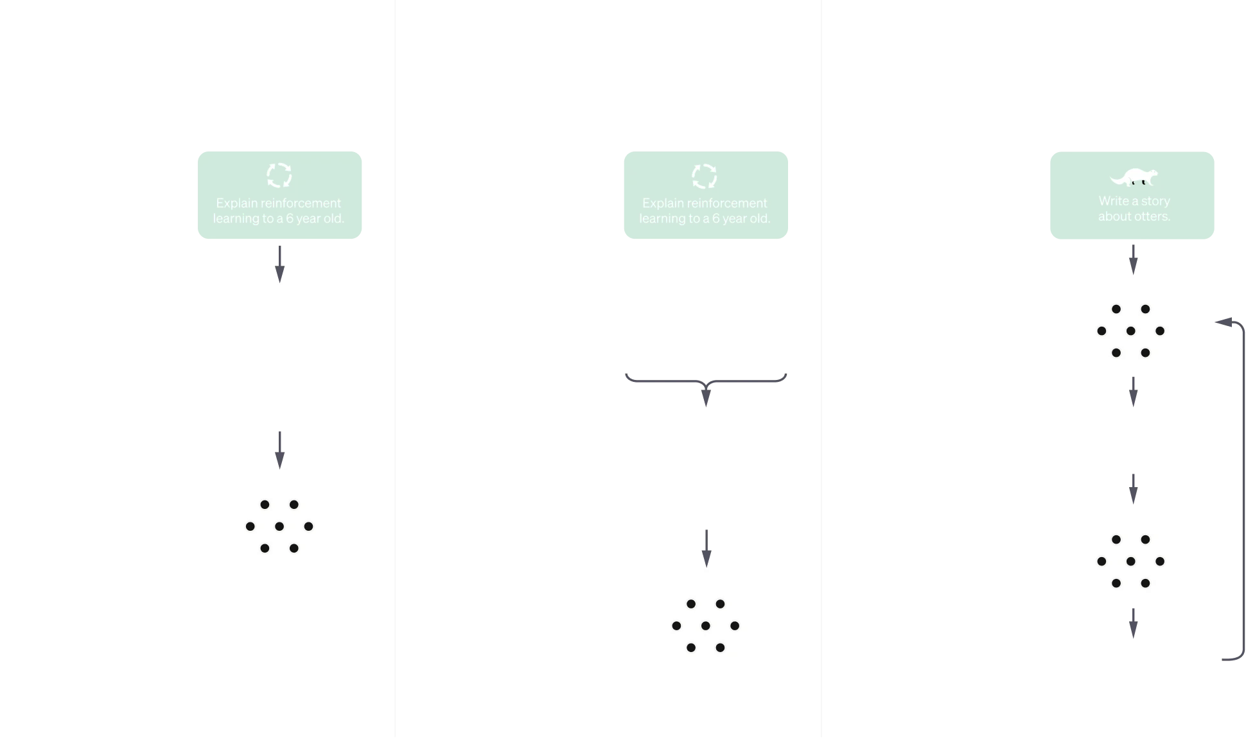
When I ask ChatGPT…

Slide 8

How much do I have to spend?
$0

Slide 9




What do I need?
Automated installation of the software you need
The Package Manager for Windows
Modern Software Automation
Homebrew
The Missing Package Manager for macOS (or Linux)
https://brew.sh
https://chocolatey.org

Slide 10


What do I need?
Run LLMs locally
Ollama
Get Up and Running with Large Language Models
https://ollama.com/

Slide 11


What do I need?
Glue the pieces together
Python
Python is a programming language that lets you work quickly and integrate systems more effectively
xhttps://www.python.org/

Slide 12
Demonstration

Slide 13


Let’s Chat
Thank you for coming!
Ask me stuff
gregorypatmore+poly@gmail.com
Get all the things
https://github.com/gregorypatmore/poly-symposium

